Slide 1
SVM Case Study

Slide 2
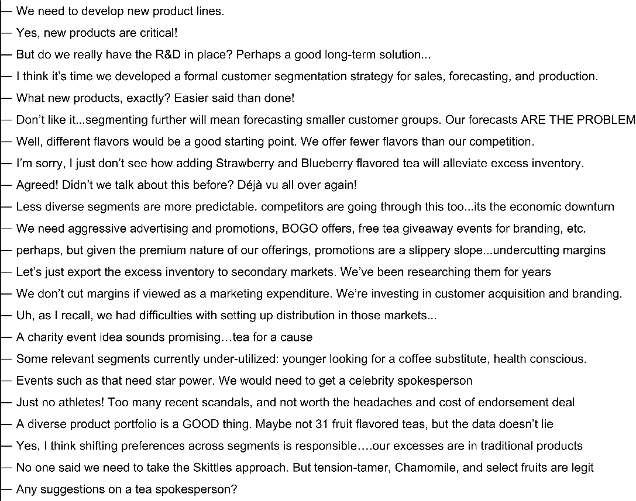
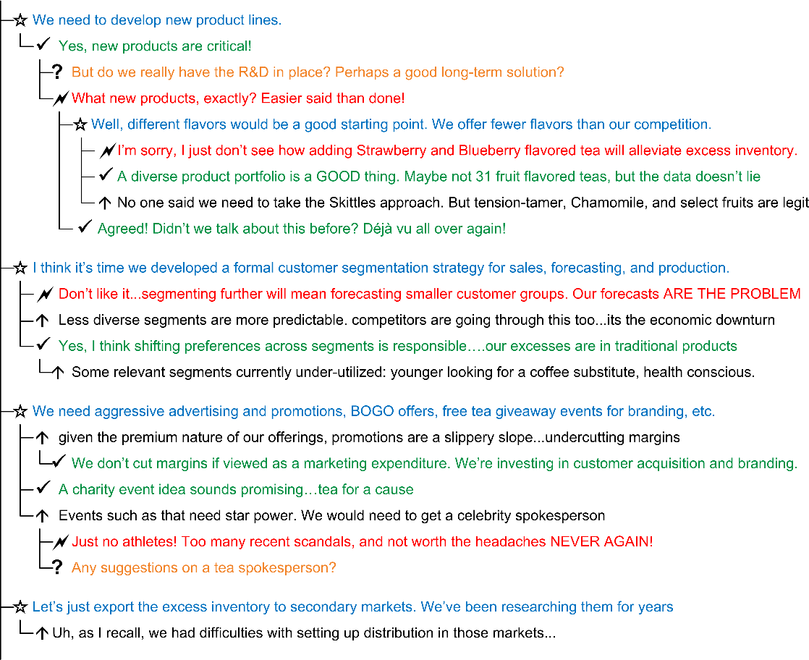
Proposed solution for Telcorp
SVM Example

Slide 3
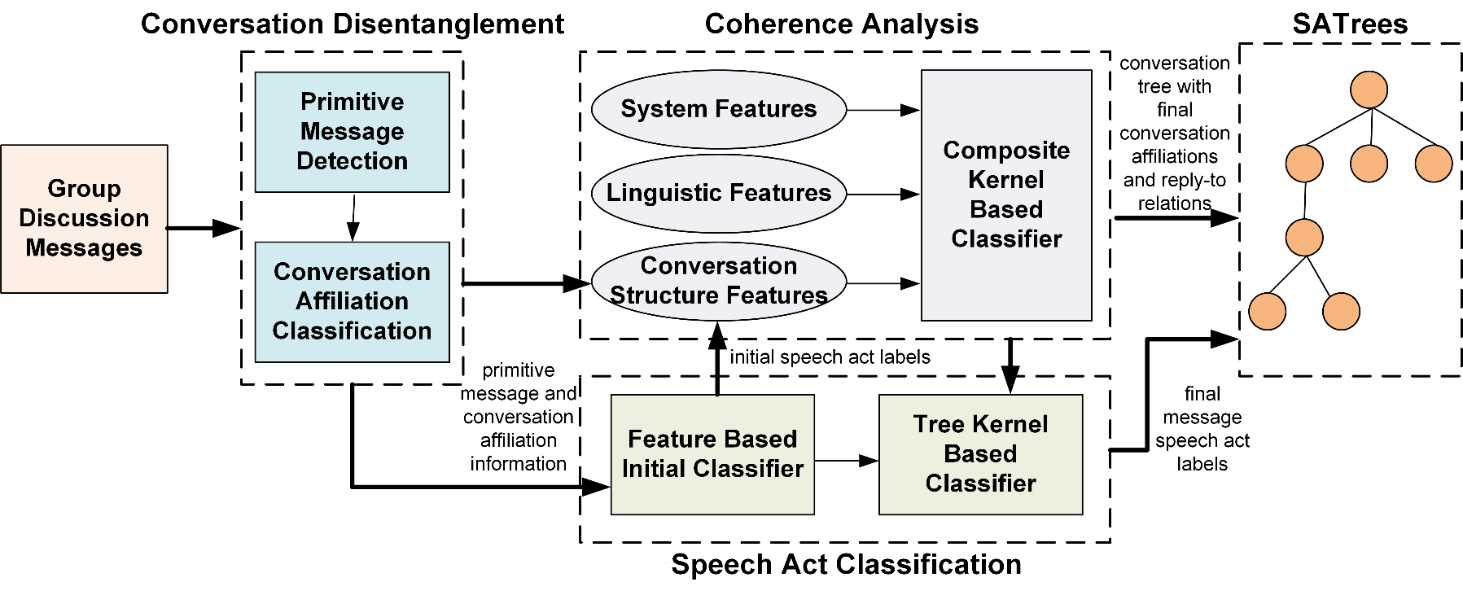
Proposed solution: SVMs
SVM Example

Slide 4
Strength of SVMs
SVM Example
85%
87%
80%
95%

